Slide 1
N

Slide 2
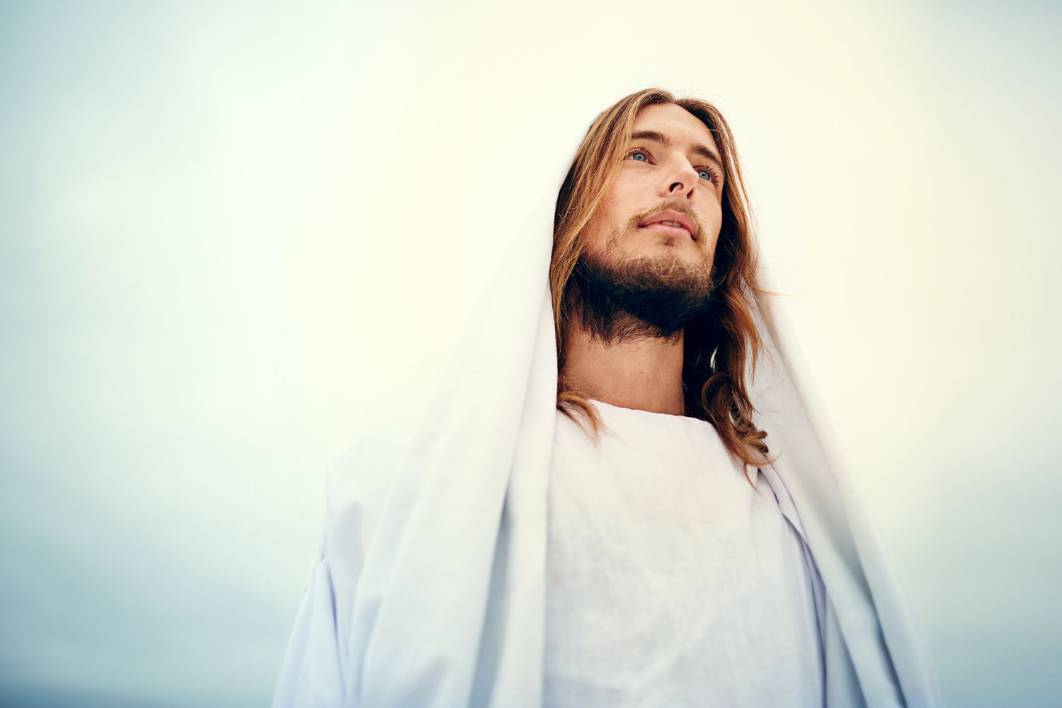
1 John 4:17b (NKJV)
… as He is, so are we in this world.
1 Corinthians 7:20
Let each one remain in the same calling in which he was called.

Slide 3
1. Humility
The OT prophets
Moses
Jesus
Paul
Their authority is not in their power or position, but in the words they spoke.

Slide 4
2. Truth
John 8:28
…I do nothing of Myself; but as My Father taught Me, I speak these things.
John 12:50
…whatever I speak, just as the Father has told Me, so I speak.”

Slide 5
3. Righteousness / Virtue
Psalm 45:4
And in Your majesty ride prosperously because of truth, humility, and righteousness; And Your right hand shall teach You awesome things.

Slide 6
As He is,
so are we in this world.
1 John 4:17b
We can step out and show Him through:
Humility
Truth
Righteousness / Virtue

